Slide 1
Network Embedding (DeepWalk/node2vec)
TA: Hongming ZHANG
Email: hzhangal@cse.ust.hk

Slide 2
Network Embedding
Input
Output

Slide 3
Applications of Network Embedding
1. Link Prediction
2. Node Classification
3. Recommendation
4. Network Visualization
……

Slide 4
Approaches
1. Random walk based
2. Graph CNN based
Many Others……

Slide 5
Random Walk Based Network Embeddings
Perozzi et al. 2014. DeepWalk: Online Learning of Social Representations. KDD.
Grover et al. 2016. node2vec: Scalable Feature Learning for Networks. KDD.

Slide 6
Deepwalks/node2vec
Estimate probability of visiting node v on a random walk starting from node u using some random walk strategy R.
Optimize embeddings to encode these random walk statistics.
Convert graph into list of nodes
Train embedding with Word2Vec

Slide 7
Why Random Walks?
Expressivity: Flexible stochastic definition of node similarity that incorporates both local and higher-order neighborhood information.
Efficiency: Do not need to consider all node pairs when training; only need to consider pairs that co-occur on random walks.

Slide 8
In this Tutorial
1. Load data into graph with networkx
2. Implement the random walk process.
3. Train the embedding with Gensim.
4. Test the performance of learned embedding with Link prediction.

Slide 9
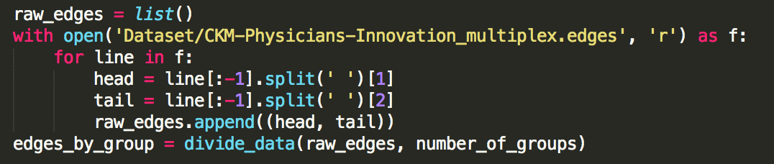
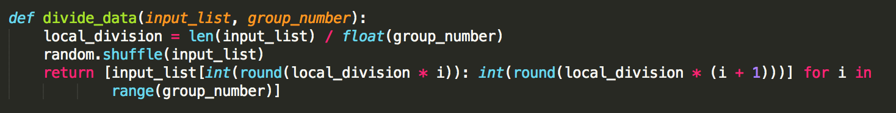
Load Data and Split Data
More data are available: http://deim.urv.cat/~alephsys/data.html

Slide 10
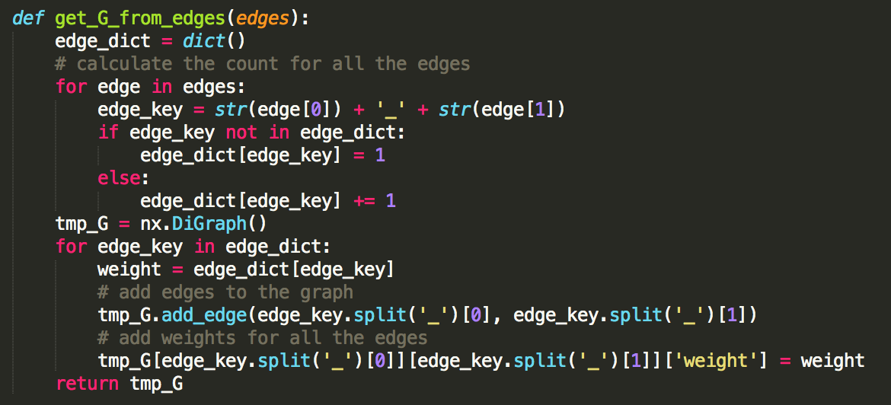
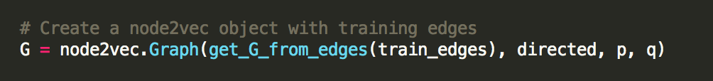
Create a graph object with loaded edges
List of edges
graph

Slide 11
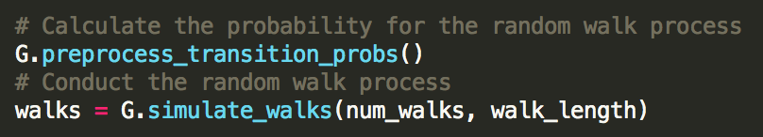
Generate random walks
Generate Probabilities for all edges.
Conduct the random walk process.

Slide 12
Train the embeddings with Gensim
Dimension of vectors
Minimum appearance
Number of CPUs
List of list of nodes
Window size of word2vec
Sg/cbow
Number of iterations

Slide 13
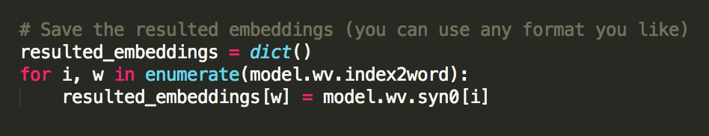
Save embeddings

Slide 14
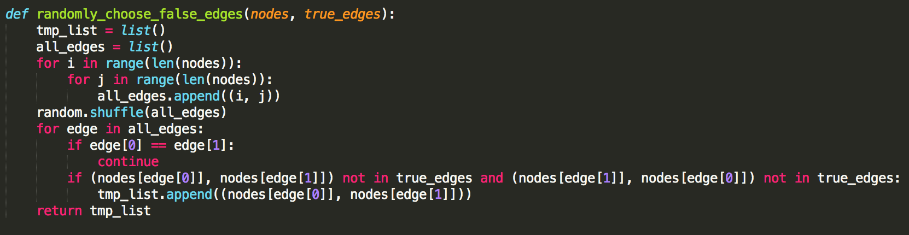
Link Prediction
Generate the negative edges

Slide 15
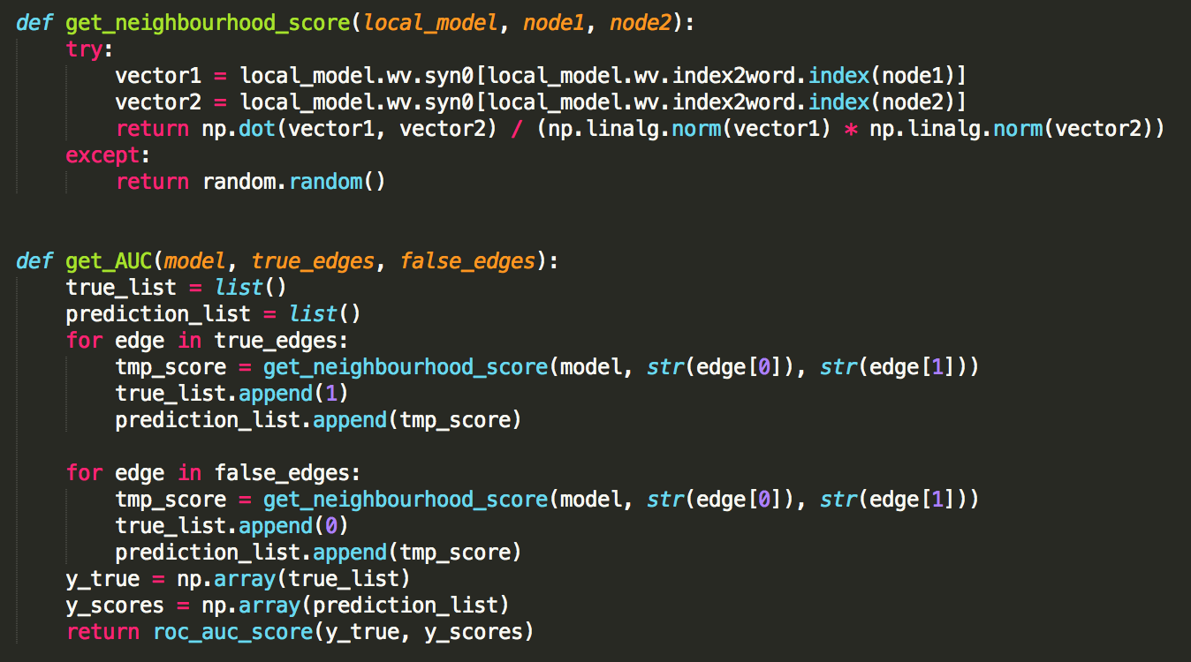
Link Prediction
Predict the relation between nodes with their cosine similarity and calculate the AUC-ROC score.

Slide 16
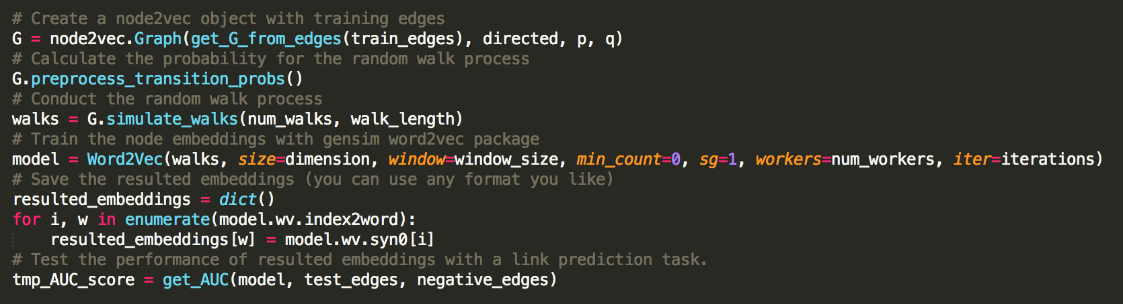
In this Tutorial

Slide 17
Q&A

